Slide 1
Operating Systems
Course #10 Virtual Memory
Răzvan Daniel ZOTA
Faculty of Cybernetics, Statistics and Economic Informatics
zota@ase.ro
https://zota.ase.ro/os

Slide 2
Contents
Memory types & memory hierarchy
Virtual memory (VM)
Page replacement algorithms in case of VM

Slide 3
Memory hierarchy
Cache
Main memory
CPU registers
I/O devices
Memory bus
I/O bus

Slide 4
Memory hierarchy

Slide 5
Memory types
The price is growing
Cache
Main memory
CPU registers
I/O devices
Memory bus
I/O bus
Dimension and access time is growing

Slide 6
The gap between DRAM, SRAM, disk and CPU

Slide 7
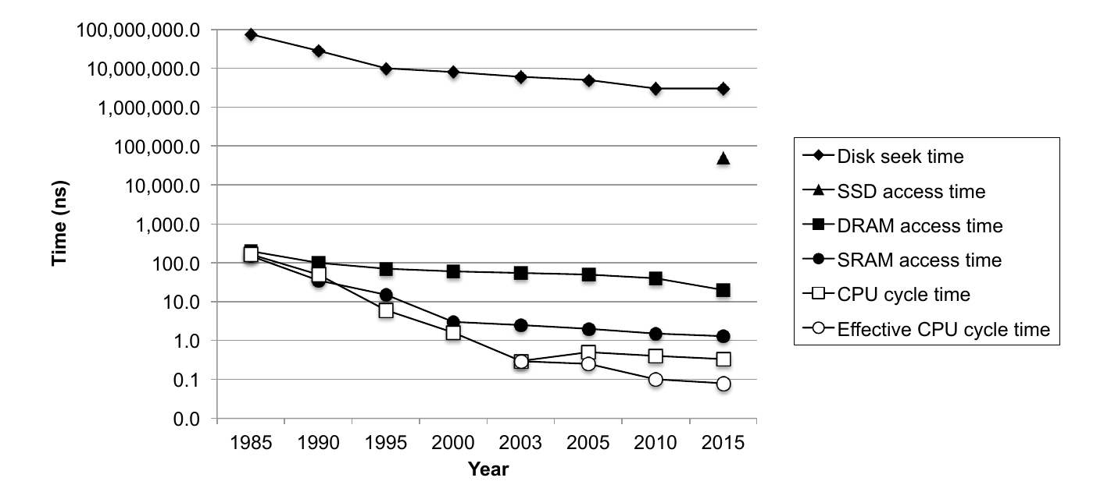
The gap between DRAM, SRAM, disk and CPU (cont.)
Similar evolution up to 2015 and present time:

Slide 8
Cache memory
Small, ultra-fast memory, inside the CPU(or close to the CPU ), containing the most recently accessed data and/or instruction code
Principle of Locality: Programs tend to use data and instructions with addresses near or equal to those they have used recently
Principle of “temporal locality” – Recently referenced items are likely to be referenced again in the near future, meaning that it is very probably to need the data soon, so it is placed into cache, where we can access quickly.
Principle of “spatial locality” - Items with nearby addresses tend to be referenced close (or relatively close storage locations) together in time.
Notes:
https://sabercomlogica.com/en/a-case-study-intel-nehalem-i7-coherence-in-cache/
http://csillustrated.berkeley.edu/PDFs/handouts/cache-3-associativity-handout.pdf

Slide 9
Cache memory
For these reasons, we may have:
A “Cache hit”, or
A “Cache miss” (a data block of fixed dimension containing the data necessary to be extracted from the main memory and inserted into the cache memory)
The time necessary for a “cache miss” depends of the memory latency and the bandwith – and will determine the time needed to read the whole memory block. A “cache miss” managed by hardware will determine a break in CPU functioning – until the moment when the data are available.
https://sabercomlogica.com/en/a-case-study-intel-nehalem-i7-coherence-in-cache/
http://csillustrated.berkeley.edu/PDFs/handouts/cache-3-associativity-handout.pdf

Slide 10
Cache memory

Slide 11
Cache hit

Slide 12
Cache miss
Notes:
http://courses.cs.vt.edu/cs2506/Fall2014/Notes/L14.MemoryHierarchy.pdf

Slide 13
A simplified CPU architecture: Cache memory and cache memory controller
CPU
8 MB SRAM
cache
Access time: 2 ns
CCU
Cache control unit
System BUS
I/O Sub-system
16 GB DRAM
Main memory
Access time: 50 ns

Slide 14
A simplified CPU architecture: Virtual memory management unit
CPU
MMU
Memory management unit
SRAM
Cache memory
System BUS
I/O sub-system
DRAM
Main memory

Slide 15
Virtual memory
Virtual memory – It represents, in short terms, the use of the disk as an extension of the RAM memory, so that the effective dimension of the usable memory is increased. In this way, we can have a virtual memory of big dimensions, larger than the physical memory.
Memory pages
Virtual memory
Memory map
Physical memory (RAM)
Disk

Slide 16
Virtual memory
In case of using virtual memory not all the objects (instructions or data) are in the main memory at a specific time; some of them may be on disk.
Addressing space is divided in fixed length blocks – called pages.
At some moment in time, the pages are in the main memory or on disk.
When the CPU tries to access an object that is not in cache, nor in the main memory, it appears a “page-fault” – in this moment the whole page is moved from the disk into main memory. These “page-faults” take a lot of time and involve swapping. Swapping is the mechanism in which a process can be swapped temporarily out of main memory to a backing storage (disk), and then brought back into memory to continue the execution.
The cache memory and the main memory have the same relation between them as the one between the main memory and the disk.

Slide 17
Virtual memory
At any moment in time, a computer runs several processes, each with its own memory address space. A part of the main memory is shared between multiple processes.
The physical memory is divided into blocks allocated to several processes.
In this case, a protection scheme is needed – this restrict the access of the processes to blocks belonging to other processes. The mechanism of virtual memory is reducing also the starting time of a program, because not all its code or data must be in main memory before starting the program.
In the case of virtual memory, the memory blocks are called pages or segments. CPU uses virtual addresses translated into physical addresses in order to access main memory. This is called memory mapping or address translation.

Slide 18
Paging
Paging represents a technique in which physical memory is broken into blocks of the same size called pages (size is power of 2, between 512 bytes and 8192 bytes).
When a process needs to be executed, it's corresponding pages are loaded into any available memory frames. Logical address space of a process can be non-contiguous and a process is allocated physical memory whenever the free memory frame is available.
Operating system keeps track of all free frames. Operating system needs n free frames to run a program of size n pages.
Address generated by CPU is divided into:
A Page number (p) -- this is used as an index into a page table which contains base address of each page from the physical memory.
A Page offset (d) – the page offset is combined with base address to define the physical memory address.

Slide 19
Paging
How paging may look:

Slide 20
Demand paging
A demand paging system is a paging system with swapping. When we want to execute a process, we swap it into memory. Rather than swapping the entire process into memory, however, it is used a swapper (called pager) to swap a page.
Program A
Program B
Physical memory
Hard-disk
Virtual memory is about main memory and hard-disk

Slide 21
Demand paging
Valid/
invalid bit
Page no.
The “rule” says that page faults are rare.
The page table needs a “resident” bit to show us if the page is in memory or not. Sometimes it is used the “valid” term to indicate residence in memory.
An “invalid” page is a non-resident page or a page with an illegal address.
Another implementation uses two bits: one bit is indicating that the page is valid and the second one is showing if the page it’s in memory or not.
1
1
1
1
0
Page table

0
Resident bit
Valid/
invalid bit
Page no.
1
1
0
0

Slide 22
Demand paging
Page fault means that a process needs a page that is not resident in memory.
The administration procedure implies the following steps (see next slide):
1. The page table is checked to see if the memory reference is valid or not.
2. If it’s valid but not resident (in memory), it is tried to obtain it from the secondary memory.
3. A free frame is searched and allocated (a physical memory page unused till present– a memory page may be needed to be freed up).
4. A disk operation it is scheduled to copy that page from the secondary memory in the new allocated frame.
5. After writing the page into memory the page table is modified – now the page is resident in memory.
6. The instruction that generated the page fault is restarted.

Slide 23
Page fault administration
OS
3
Getting the page from the secondary memory
Reference to the page table
2
P is loading
Trap
1
Restart the instruction
6
Page table
Free memory
frame
5
Page table updating
4
Copying the page into the main memory
Physical memory

Slide 24
Page replacement
When the memory is over-allocated we must swap something already loaded into memory.
Over allocation appears when the programs need more memory pages than those physically existent.
Approach: If no physical page is free, one page that it is not used is swapped, using the following steps:
1. Find the page on disk.
2. Find a free frame:
a. If exists, use it
b. Otherwise, select a “victim page” and
c. Write the “victim page” on disk.
3. Read the new page in the freed frame. Update the page table.
4. Restart the process.

Slide 25
Page replacement
Page
Valid/invalid bit
The bit will be modified in “invalid”
The “victim” page is copied on disk
2
p1
1
Victim page
p1
v
SWAP
p2
i
p2
4
3
The bit will be modified in “valid”
The needed page is copied from disk to memory
Page table
Physical memory
The page replacement mechanism

Slide 26
Page replacement algorithms: FIFO
Page replacement algorithms are the techniques used by the OS to decide which memory pages to swap out (write to disk) when a page of memory needs to be allocated.
What pages are to be replaced? – in order to minimize the number of page faults.
Suppose we consider the following reference string for memory pages to be replaced:
1, 2, 3, 4, 1, 2, 5, 1, 2, 3, 4, 5
1
5
4
FIFO
Easy to implement. Oldest page in main memory is the one which will be selected for replacement.
It can be used a “time-stamp” for pages, or an organization in a queue (the easiest method).
2
1
5
10 “page faults”
3
2
4
3
Reference string: 1, 2, 3, 4, 1, 2, 5, 1, 2, 3, 4, 5

Slide 27
Page replacement algorithms: Optimal replacement
Represents a page replacement policy for the pages that have the smallest “page fault” rate.
The algorithm: we replace the page that will not be used for the longest period of time.
Practically is impossible to implement it.
1
4
2
6 “page faults”
3
4
5
Reference string: 1, 2, 3, 4, 1, 2, 5, 1, 2, 3, 4, 5

Slide 28
The LRU(Least Recently Used) algorithm
It replaces the page that have not been used for the longest period of time.
The results are good
Implementation alternatives:
Using a ”time stamp” for pages - record the last use.
Using a list – replace pages by looking back into time.
1
5
2
8 “page faults”
3
5
4
4
3
Reference string: 1, 2, 3, 4, 1, 2, 5, 1, 2, 3, 4, 5

Slide 29
Short introduction – VM in Linux
Virtual memory in Linux: https://www.tldp.org/LDP/sag/html/vm-intro.html

